Slide 1


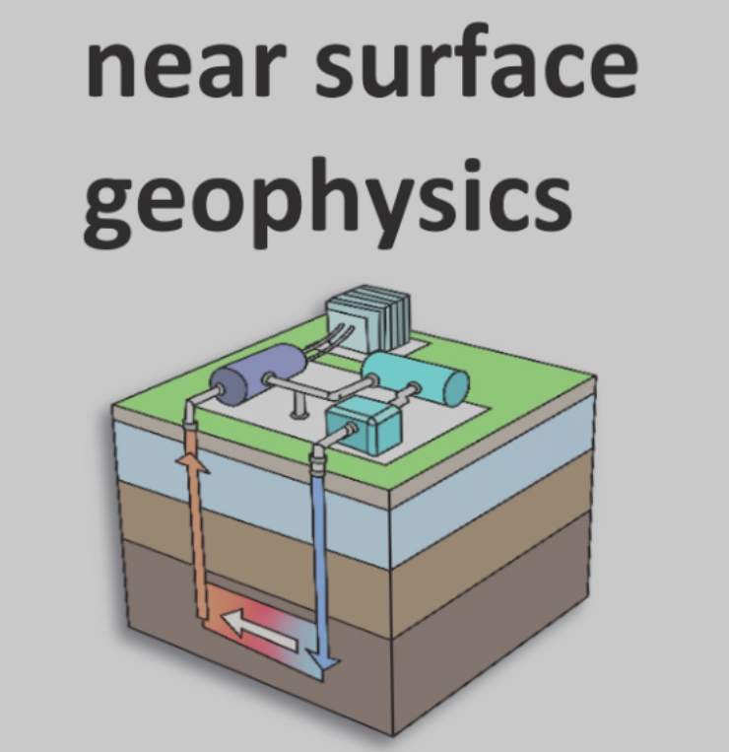

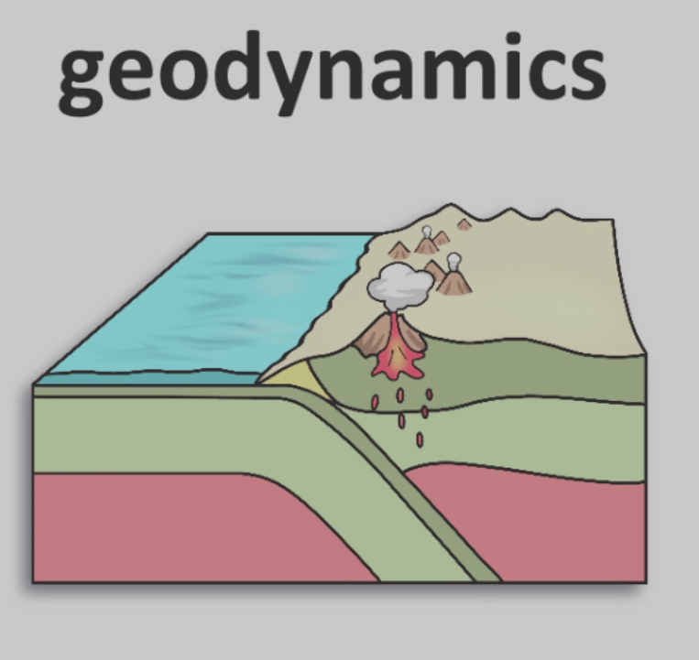


NSF Science Priorities 2020-2030
Earth in time
Dynamic properties of Earth and Planetary materials

Slide 2

In-Situ Studies of Rock Deformation (ISRD): Research Coordination Network
Goal: Collaboration, Innovation, and Transformation
Charge: “…facilitate the integration of beamline technologies with deformation experiments and create new directions for experimental rock deformation research.”
Task: Host a series of five workshops at synchrotron and neutron sources that bring together geophysicists and beamline scientists to identify pressing research challenges that can be addressed using synchrotron X-ray and neutron capabilities
  Science Workshops:
    CHESS Workshop (June 2020, Virtual)
    APS Workshop (January 2021, Virtual)
    NIST Neutron Workshop (July 2023, in-person)
    ILL/ESRF NeXT Workshop (May 2024, in-person)
  Hands-on training sessions
    Shadow a beamline user (Fall 2022, Spring 2023 APS 6-BMB)
    Acoustic Emission Workshop (March 2023 APS GSECARS)
    Nanotomography Workshop (April 2024, ALS)
EAR-1926627

Slide 3
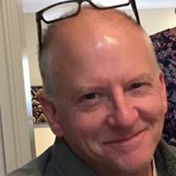

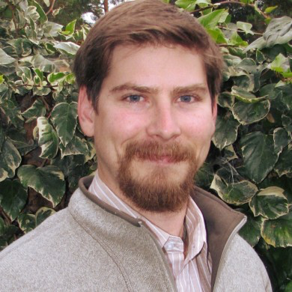
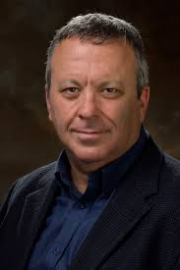
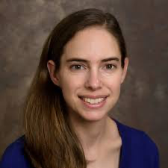
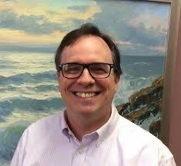
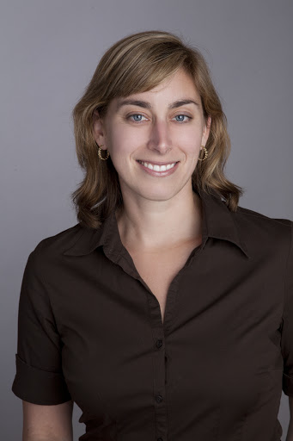

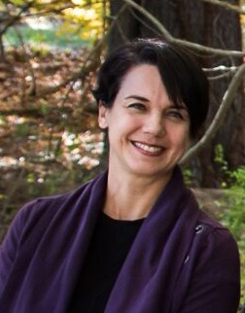
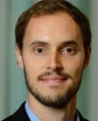
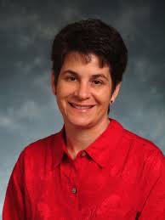
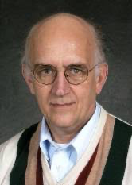
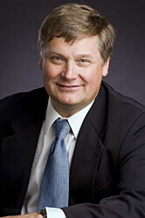

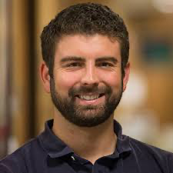
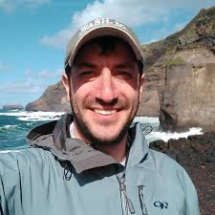
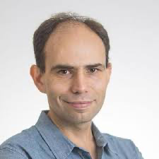
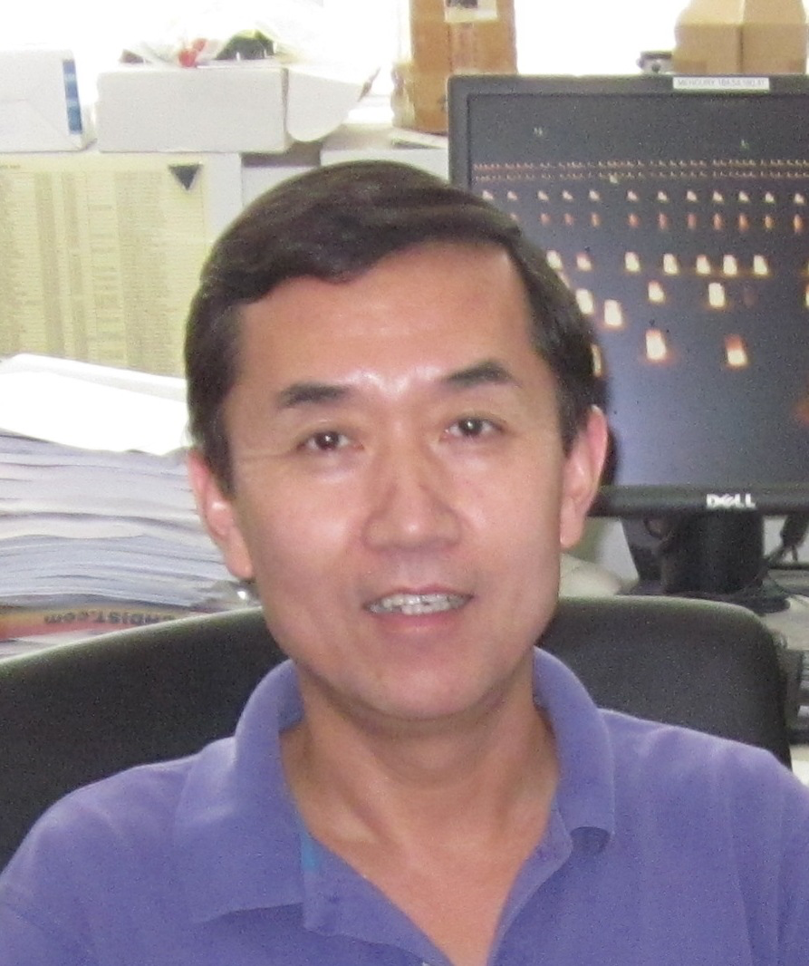
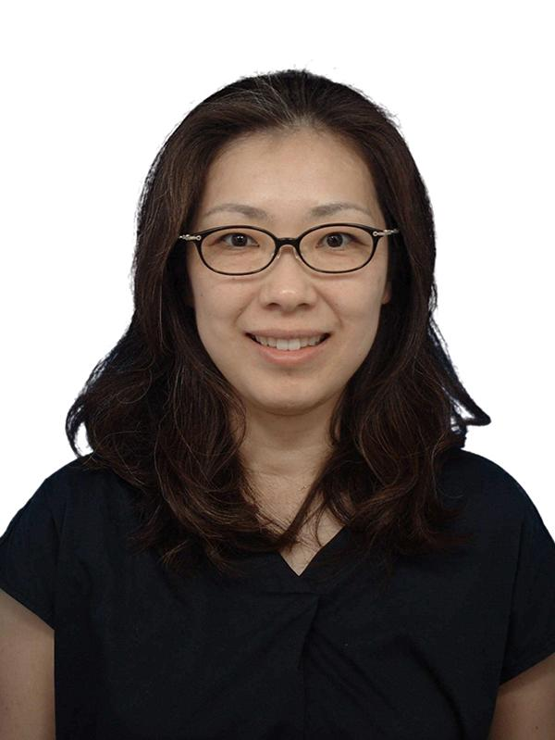
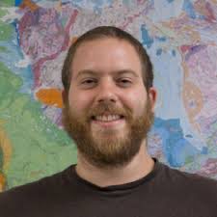
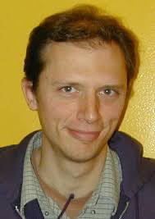
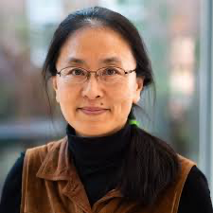
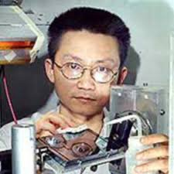
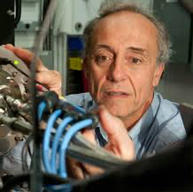
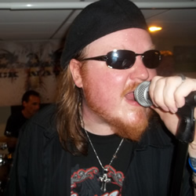
Collaboration, Innovation and Transformation
Steering Committee

Slide 4
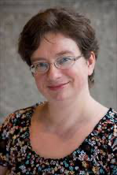
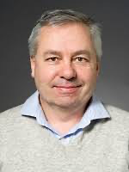
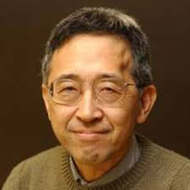
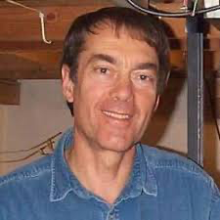
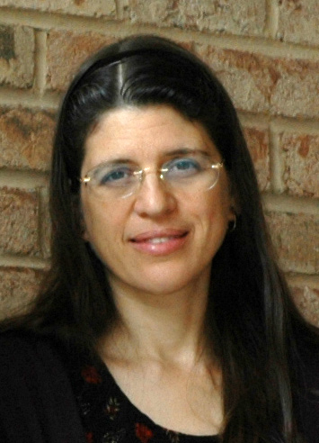
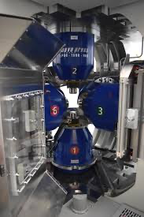
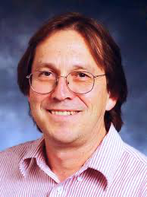
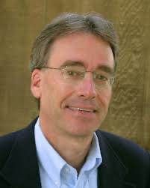
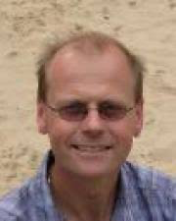
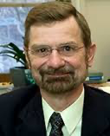
Collaboration, Innovation and Transformation
Advisory Committee
Robert Farla

Slide 5
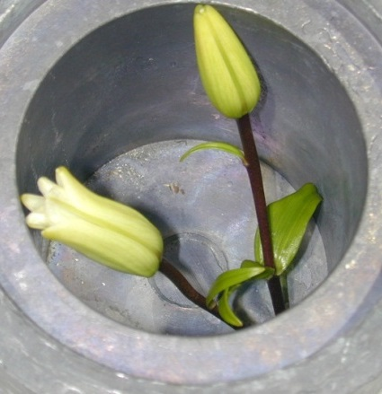
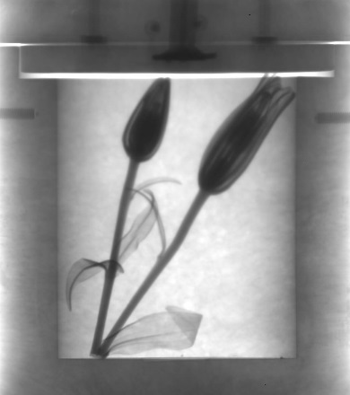
Neutrons & NIST
Daniel S. Hussey
Physical Measurement Lab
National Institute of Standards and Technology

Slide 6
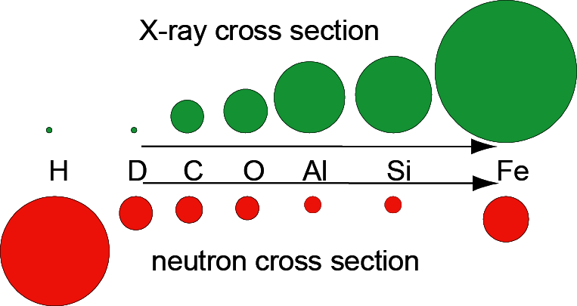
Complementarity of multimodal data can enable new science

Slide 7
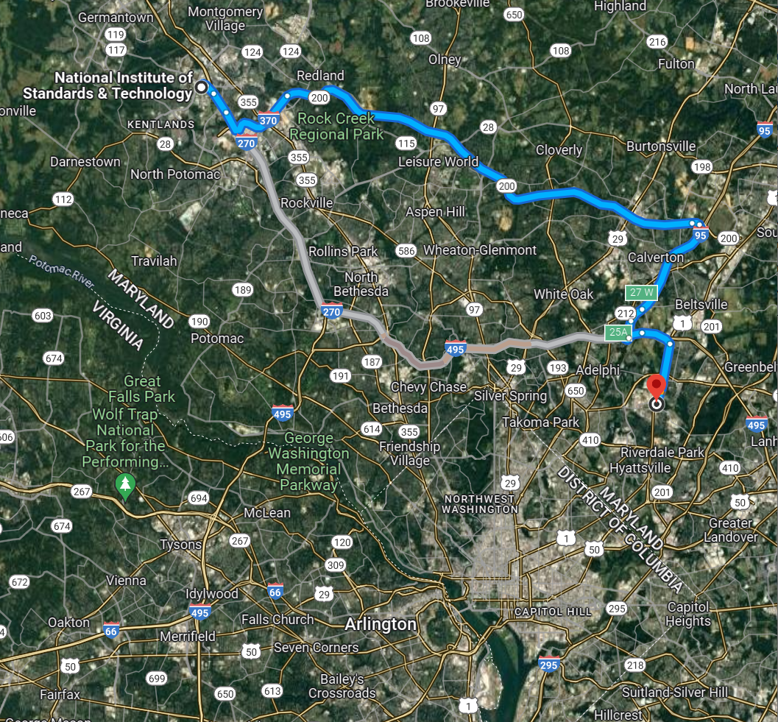
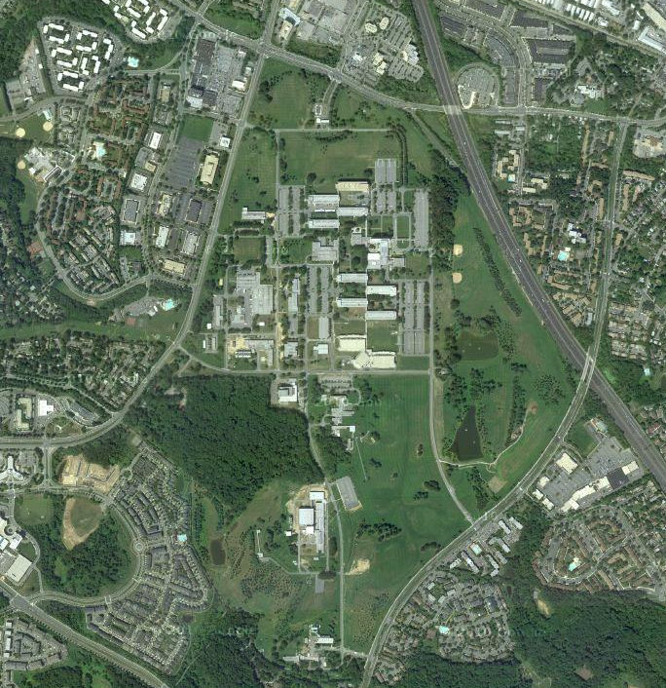
National Institute of Standards and Technology (NIST, in USA)
Main Campus Located in Gaithersburg, MD USA
Satellites in Boulder, CO and Charleston, SC
~15 miles north of Washington D.C.
Established 1901, First U.S. National Lab
650 acres, 3000 staff, 3000 associates, 4 Nobel Laureates
NCNR

Slide 8
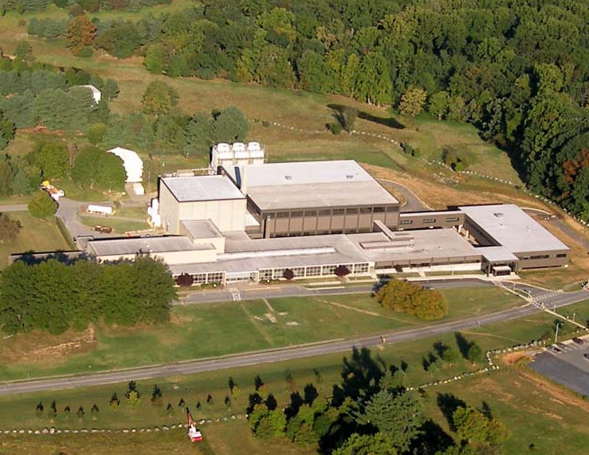
NIST Center for Neutron Research (NCNR)
20 MW Research Reactor
Operating since 1967, re-licensed to run (at least) until 2029
Largest neutron scattering user program in the U.S.
28 thermal and cold neutron scattering and imaging facilities

Slide 9
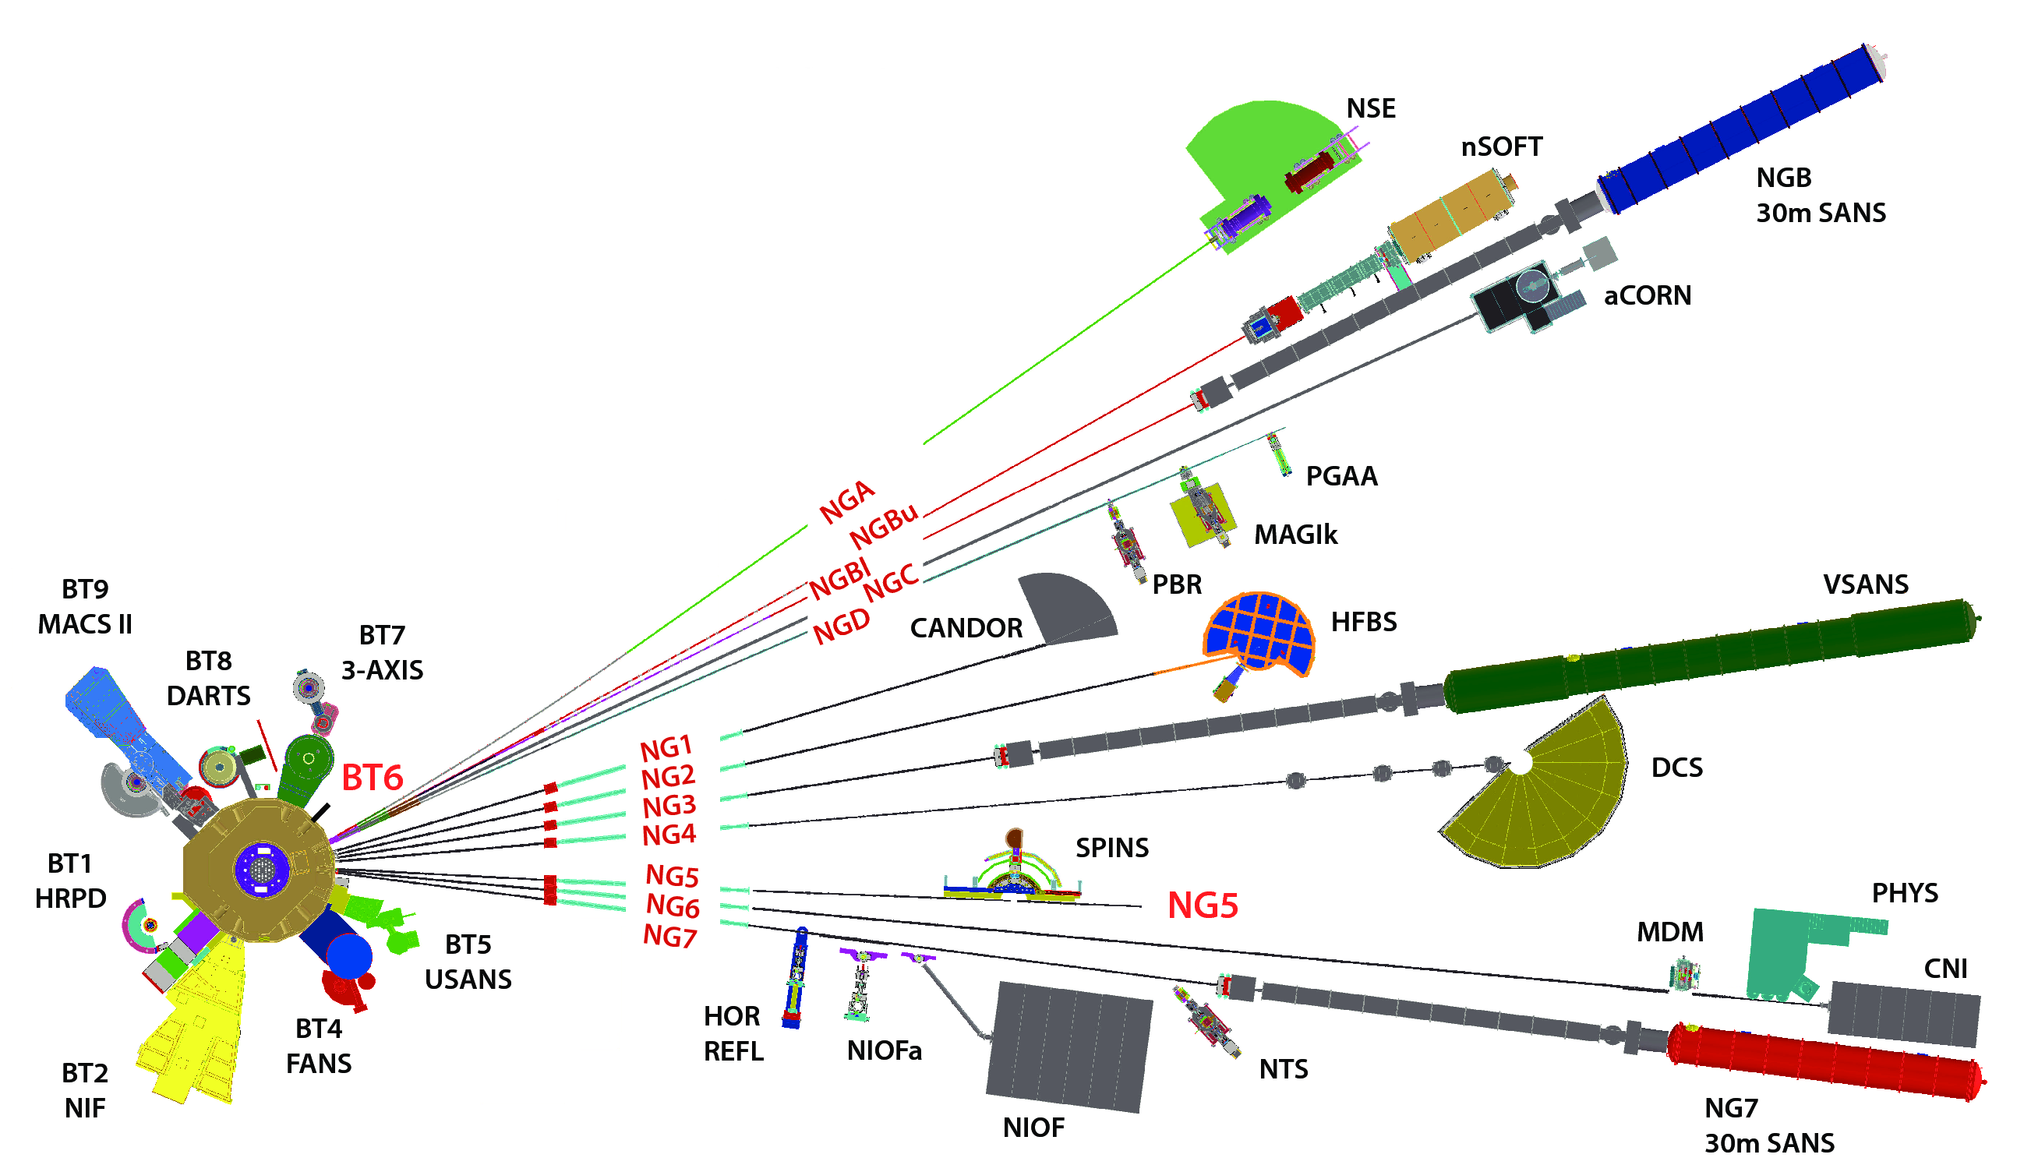
NCNR Instruments
Guide Hall
C100

Slide 10
Poster talks!
If you want to introduce yourself and your poster, please sign up!
1 minute only, no slide … try to explain your poster or question you want to ask with an “elevator speech”
Poster talks: 16:00 – 16:30
Poster session 1: 16:30 – 19:00
Poster session 2: Tuesday, after ILL / ESRF Tours

Slide 11
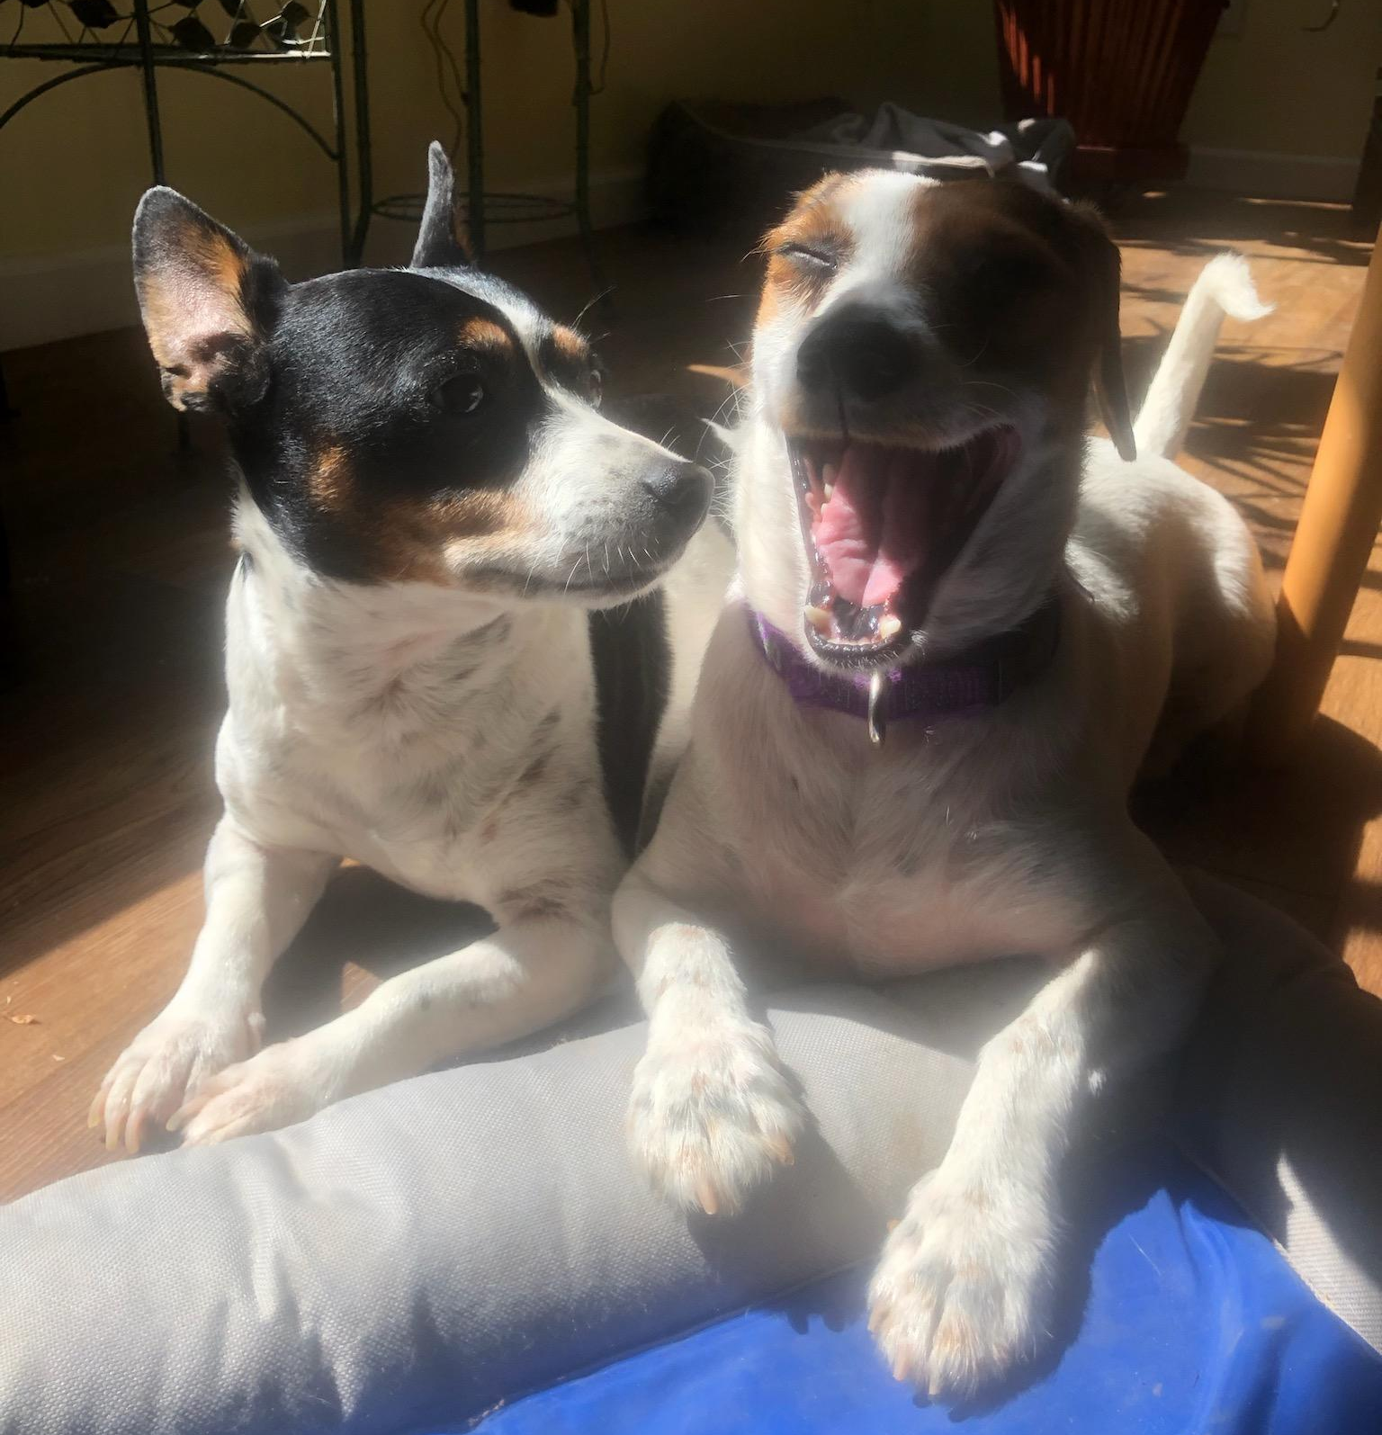
We are all here to share our expertise and to learn from one another.

